Slide 1
1) What is LOGISTIC REGRESSION?
2) Why not Linear Regression?
Pros and cons of Logistic Regression
Assumptions of Logistic Regression
Examples of Logistic Regression
Evaluating goodness of fit
Interpret odds ratio

Slide 2
1) What is LOGISTIC REGRESSION?
What is Regression?
Regression is a statistical procedure which attempts to predict the values of an outcome or dependent or target variable based on the values of one or more other independent or predictor variables. For example, find the growth of a company based on current economic conditions.
The result of a regression is usually an equation which summarizes the relationship between dependent and independent variables.

Slide 3
1) What is LOGISTIC REGRESSION? - continued
What is Linear Regression?
Linear Regression quantifies the relationship between one or more predictor variables and one target or outcome variable, that is a continuous numeric variable.
For example, we use linear regression to predict the sales of a product (dependent variable) using the amount spent of advertising in that year as the independent variable.
For example, the linear regression equation is
Sales = 2500 + 25 Advertising Expenses

Slide 4
1) What is LOGISTIC REGRESSION? - continued
What is Logistic Regression?
Logistic Regression is a predictive modelling algorithm to predict the outcome of a binary dependent variable using one or more nominal, interval or ratio-level independent variables.
A few examples of binary classification problem:
a) Spam detection: Predicting if an email is SPAM or not
b) Loan default: Predicting if a loan customer will default or not
c) Customer Churn: Predicting if a customer will churn or not

Slide 5

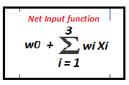
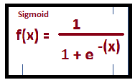
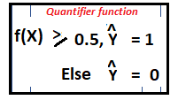

1) What is LOGISTIC REGRESSION? - continued
Intercept, w0
Error
Number of hours studied
Value from 0 to 50
w1
Marks in mock exam attended Value from 0 to 100
Pass
w2
w3
Attended tutorials
(y/n)
Fail
X: Independent variables Weights: w0, w1, w2 and w3 Output: Pass or Fail

Slide 6
2) Pros and cons of Logistic Regression
Pros
Low variance
Provides probabilities for outcomes
Works well with diagonal (feature) decision boundaries
Note: Logistic Regression can be used with kernel methods
Cons
High bias
ttps://github.com/ctufts/Cheat_Sheets/wiki/Classification-Model-Pros-and-Cons

Slide 7
3) Assumptions of Logistic Regression
Binary logistic regression requires the target / dependent variable to be binary. For a binary regression, the factor level 1 of the dependent variable should represent the desired outcome (such as Success etc..).
Only the meaningful variables should be included.
The predictor variables should not be correlated to each other meaning the model should have little or no multicollinearity.
The independent variables are linearly related to the log odds.
Logistic regression requires quite a large number of observations. A general guideline is that you need at least 20 cases with the least frequent outcome for each independent variable in your model.

Slide 8

4) Why not Linear Regression?
When the response variable has only two possible values, it is desirable to have a model that predicts the value either as 0 or 1 or as a probability score that ranges between 0 and 1.
Linear regression does not have this capability. Because, if you use linear regression to model a binary response variable, the resulting model may not restrict the predicted Y values within 0 and 1.
One of the assumptions of linear regression is that the variance of Y is constant across values of X (homoscedasticity). This cannot be the case with a binary variable, because the variance is pq where p is the probability of an event occurring and q not occurring. As p approaches o or 1, variance approaches 0.
The significance testing of b weights rest upon the assumption that errors of prediction are normally distributed. Since Y only takes the values 0 and 1, this assumption is hard to justify.
Note: Errors of prediction is

Slide 9
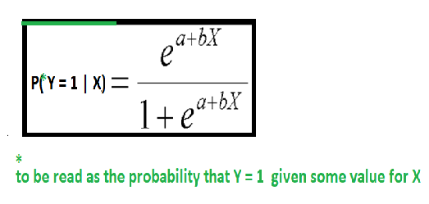
4) Why not Linear Regression? - continued
Logistic Regression model predicts the probability of the target value being 1
where P is the probability of a 1 (the proportion of 1s, the mean of Y), e is the base of the natural logarithm (about 2.718) and a and b are the parameters of the model.
Note: Value of P cannot exceed 1 since denominator is greater than numerator.
http://faculty.cas.usf.edu/mbrannick/regression/Logistic.html

Slide 10
5) How does Logistic Regression work?
https://www.hackerearth.com/practice/machine-learning/machine-learning-algorithms/logistic-regression-analysis-r/tutorial/
Logistic Regression assumes that the dependent (or response) variable follows a binomial distribution.
Binomial distribution can be identified by the following characteristics:
1. There must be a fixed number of trials denoted by n, i.e. in the data set, there must be a fixed number of rows.
2. Each trial can be only two outcomes i.e.. the response variable can have only two unique categories.
3. The outcome of each trial must be independent of each other; i.e.. the un ique levels of the response variable must be independent of each other.
4. The probability of success (p) and failure (q) should be the same for each trial.
In Logistic Regression, we calculate probabilities and they always lie between 0 and 1.
Hence. we have the conditions:
The response value is lower than 1 and value must be positive.
It is known that exponential of any value is always positive.
Any number divided by the same number + 1 is always lower than 1.

Slide 11
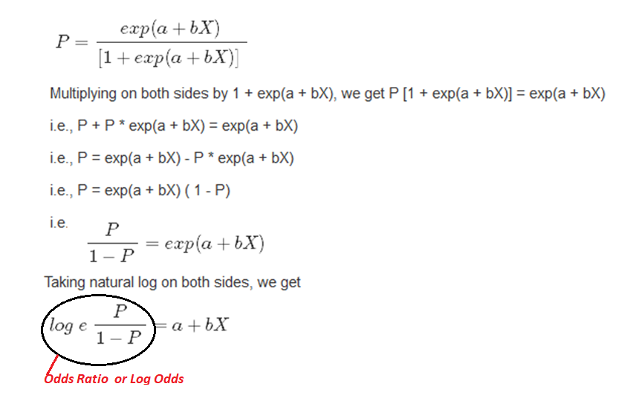
5) How does Logistic Regression work?
https://www.hackerearth.com/practice/machine-learning/machine-learning-algorithms/logistic-regression-analysis-r/tutorial/

Slide 12
6) How to estimate the model coefficients ?
For Linear Regression models, coefficients are estimated by using Ordinary Least Squares method (OLS).
For Logistic Regression models, coefficients are estimated by using Maximum Likelihood Estimate (MLE).
Maximum Likelihood Estimate
The objective of the MLE is to choose values for the estimated parameters (betas) that would maximize the probability of observing the Y values in the sample with the given X values.
MLE provides the maximum explanatory power of the model given the available data.
http://www.saedsayad.com/logistic_regression.htm

Slide 13
7) How to check model fitness? - continued
A pseudo R² value is used to test the adequacy of the regression model.
Likelihood Ratio Test
This test provides the means for comparing the likelihood of the data under one model (e.g. full model) against the likelihood of the data under another, more restricted model (e.g. intercept only model).
Given that the null hypothesis holds that the reduced model is true, a p-value for the overall model fit statistic that is less than 5% (assume we have set 5% as our level of significance) would result in rejecting the null hypothesis in favour of alternative hypothesis.
Formula for LR statistic is given below:
LR = 2 [ln(L(m2)) - ln(L(m1))]
where
ln denotes the natural log
L(m2) denotes the maximum likelihood of the full model and L(m1) denotes the maximum likelihood of the restricted model
http://www.saedsayad.com/logistic_regression.htm

Slide 14
7) How to check model fitness? - continued
Likelihood Ratio Test using R
We will use the German Credit dataset in the caret package. It contains 62 characteristics and 1000 observations with the target variable, class. The response variable is coded as 0 for bad customer and 1 for good.
Assume our Null hypothesis holds that the reduced model is a good predictor of response variable,
Class.
Check the p-value for the overall model fit statistic. If it is less than 0.05, it would provide evidence against the reduced model in favour of the current model.
The likelihood ratio test can be performed in R using the lrtest() function from the lmtest package or using the anova() function in base.
Let us check define the restricted model, mod_fit_1 with just two predictor variables and perform the likelihood ratio test
http://www.saedsayad.com/logistic_regression.htm

Slide 15
7) How to check model fitness? - continued
Likelihood Ratio Test using R
library(caret)
library(lmtest)
data(GermanCredit)
TrainIndex <- createDataPartition(GermanCredit$Class, p=0.7, list=FALSE)
training_data <- GermanCredit[TrainIndex,]
testing_data <- GermanCredit[-TrainIndex,]
dim(training_data)
## [1] 700 62
#Using the training dataset, which contains 700 observations, we will use logistic regression to model Class as a function of five predictors.
fit <- glm (Class ~ Age + ForeignWorker + Property.RealEstate + Housing.Own + CreditHistory.Critical, data=training_data, family="binomial")
fit_1 <- glm(Class ~ Age + ForeignWorker, data=training_data, family="binomial")
print((anova(fit, fit_1, test ="Chisq")))
## Analysis of Deviance Table
##
## Model 1: Class ~ Age + ForeignWorker + Property.RealEstate + Housing.Own +
## CreditHistory.Critical
## Model 2: Class ~ Age + ForeignWorker
## Resid. Df Resid. Dev Df Deviance Pr(>Chi)
## 1 694 807.10
## 2 697 844.32 -3 -37.214 4.145e-08 ***
## ---
## Signif. codes: 0 '***' 0.001 '**' 0.01 '*' 0.05 '.' 0.1 ' ' 1

Slide 16
7) How to check model fitness? - continued
Likelihood Ratio Test using R – continued
lrtest(fit, fit_1)
## Likelihood ratio test
##
## Model 1: Class ~ Age + ForeignWorker + Property.RealEstate + Housing.Own +
## CreditHistory.Critical
## Model 2: Class ~ Age + ForeignWorker
## #Df LogLik Df Chisq Pr(>Chisq)
## 1 6 -403.55
## 2 3 -422.16 -3 37.214 4.145e-08 ***
## ---
## Signif. codes: 0 '***' 0.001 '**' 0.01 '*' 0.05 '.' 0.1 ' ‘ 1
Since the p-value is < 0.05 (in fact, it is 0.00000004145), we conclude that the full model fits better than the reduced model.
http://www.saedsayad.com/logistic_regression.htm

Slide 17
7) How to check model fitness? - continued
A pseudo R² value is used to test the adequacy of the regression model.
There are several measures intended to mimic the R² analysis to evaluate the goodness of fit of logistic models.
McFadden R² = 1 – LL_{full_model} / LL_{intercept}
The ratio of the log-Likelihoods suggests the level of improvement over the intercept model offered by the full model.
Values from 0.2-0.4 indicate (in McFadden's words) excellent model fit
Using R
library(pscl)
pR2(fit)['McFadden'] # look for 'McFadden'
## McFadden
## 0.05529888 << Poor Fit
http://www.saedsayad.com/logistic_regression.htm

Slide 18
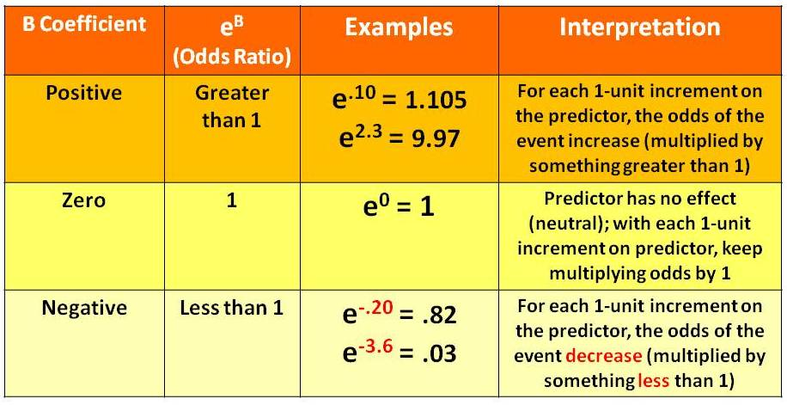
7) Interpret odds ratio

Slide 19
5) Examples of Logistic Regression

